Slide 1
Testing of Hypothesis

Slide 2
Hypothesis
An assertion or statement about unknown population parameter is called hypothesis
A hypothesis is an educated guess about something in the world around you. It should be testable, either by experiment or observation. For example:
A new medicine you think might work.
A way of teaching you think might be better.
A possible location of new species.
A fairer way to administer standardized tests.

Slide 3
Hypothesis Statement
If you are going to propose a hypothesis
If I…(do this to an independent variable)….then (this will happen to the dependent variable).
If I (decrease the amount of water given to herbs) then (the herbs will increase in size).
If I (give patients counseling in addition to medication) then (their overall depression scale will decrease).
If I (give exams at noon instead of 7) then (student test scores will improve).
If I (look in this certain location) then (I am more likely to find new species).

Slide 4
Good Hypothesis Statement
According to the University of California
Good hypothesis statement should
Include an “if” and “then” statement.
Include both the independent and dependent variables.
Be testable by experiment, survey or other scientifically sound technique.
Be based on information in prior research (either yours or someone else’s).
Have design criteria (for engineering or programming projects).

Slide 5
Hypothesis Testing
Hypothesis testing in statistics is a way for you to test the results of a survey or experiment to see if you have meaningful results.
Testing whether your results are valid by figuring out the odds that your results have happened by chance.
If your results may have happened by chance, the experiment won’t be repeatable and so has little use.

Slide 6
Types of Hypothesis
Null Hypothesis: The no difference is hypothesis is called null hypothesis. This is the hypothesis which is assumed to be true in testing procedure and is tested for its possible rejection. It always contains the sign of equality(“=”). It is usually denoted by “H₀”.
E.g. Null hypothesis regarding population mean μ, H₀: μ = μ₀
Sometimes when statements are like population mean is at least μ₀ the null hypothesis is written as H₀: μ ≤ μ₀
or
population mean is at most μ₀ the null hypothesis is written as H₀: μ ≥ μ₀ , where μ₀ is the some specified value.
Similarly Null hypothesis regarding population standard deviation σ can be stated as either
H₀: σ = σ₀ or H₀: σ ≤ σ₀ or H₀: σ ≥ σ₀
where σ₀ is the some specified value.

Slide 7
Types of Hypothesis
Alternative Hypothesis: Corresponding to every null hypothesis, an complementary hypothesis is stated which is assumed to be true if null hypothesis is rejected. This complementary hypothesis is called Alternative hypothesis. It always contains “<” or “>” or “≠” sign. It is usually denoted by “H₁ or H_{A}”.
E.g. Alternative hypothesis regarding population mean μ, H_{A}: μ < μ₀ or H_{A}: μ > μ₀ or H_{A}: μ ≠ μ₀

Slide 8
Hypothesis Testing Steps
Figure out your null hypothesis,
State your null hypothesis,
Choose what kind of test you need to perform,
Either support or reject the null hypothesis.

Slide 9
Example
A researcher thinks that if knee surgery patients go to physical therapy twice a week (instead of 3 times), their recovery period will be longer. Average recovery times for knee surgery patients is 8.2 weeks.
The hypothesis statement in this question is that the researcher believes the average recovery time is more than 8.2 weeks. It can be written in mathematical terms as: H₁: μ > 8.2
Next, you’ll need to state the null hypothesis (See: How to state the null hypothesis). That’s what will happen if the researcher is wrong. In the above example, if the researcher is wrong then the recovery time is less than or equal to 8.2 weeks. In math, that’s: H₀ μ ≤ 8.2

Slide 10
Example
Ten or so years ago, we believed that there were 9 planets in the solar system.
Pluto was demoted as a planet in 2006.
The null hypothesis of “Pluto is a planet” was replaced by “Pluto is not a planet.” (alternate hypothesis)

Slide 11
Types of Errors
The main objective in sampling theory is to draw valid inferences about the population parameters on the basis, of the sample results. In practice we decide to accept or reject the lot after examining a sample from it. As such we are liable to commit the following two types of errors:
(a)Type I Error (b) Type II Error

Slide 12
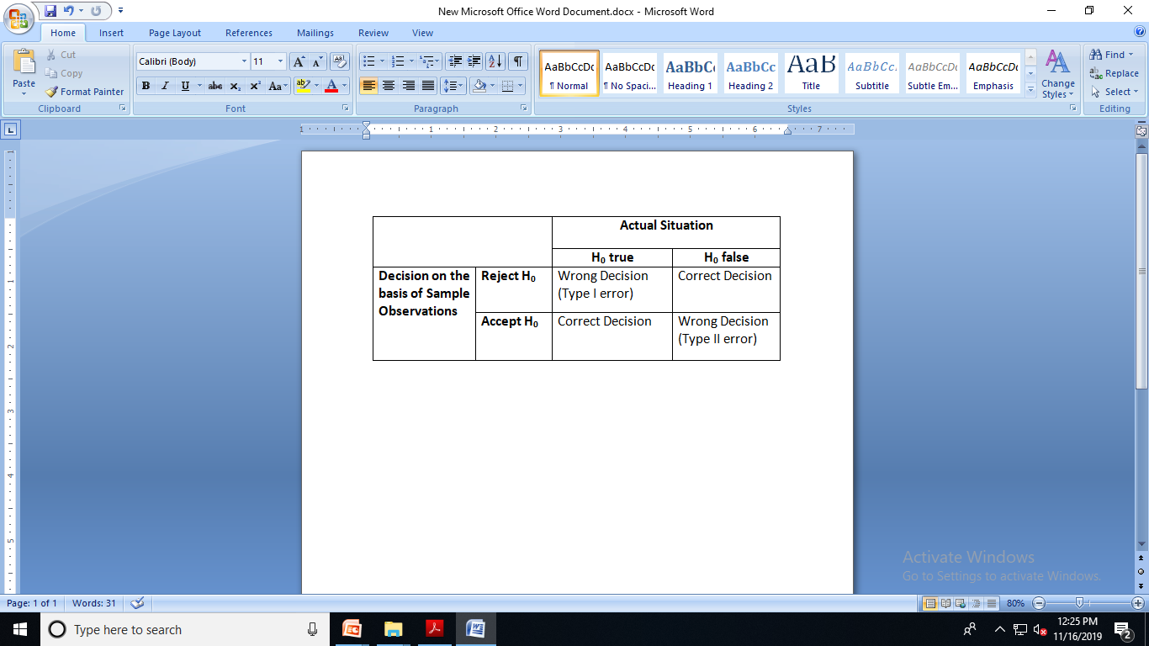
Types of Errors

Slide 13
Types of Errors
(a)Type I Error: Type I error said to occur when we reject null hypothesis on the basis of sample observations when it is actually true.
(b) Type II Error: Type II error said to occur when we accept null hypothesis on the basis of sample observations when it is actually false.

Slide 14
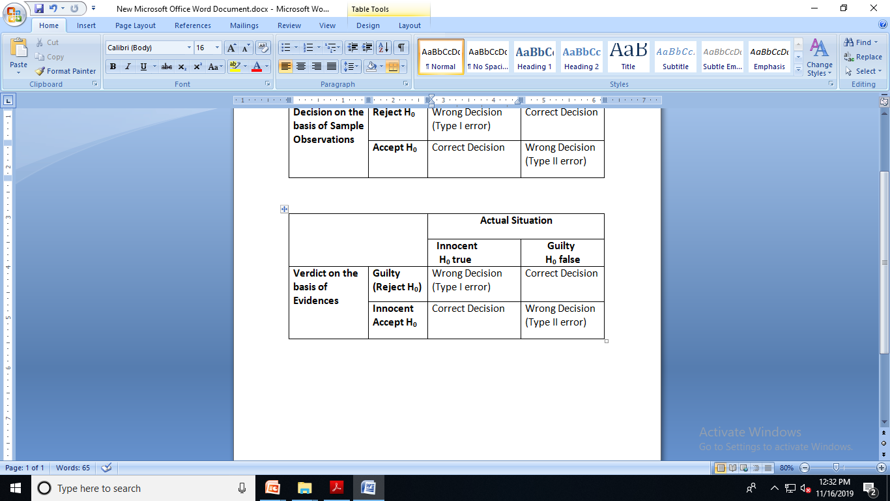
Jury Trial
H₀: Suspect is Innocent H₁: Suspect is Guilty

Slide 15
Level of Significance and power of the test
Level of Significance: Probability of committing type I error i.e. rejecting null hypothesis when it is true is called level of significance. It is usually denoted by α .
Power of the test: Probability of rejecting null hypothesis when it is false is called Power of the test.
Usually Probability of committing type II error i.e. accepting null hypothesis when it is false is denoted by β . Therefore power of the test is given by 1-β

Slide 16
α & β Have an Inverse Relationship
Reduce probability of one error and the other one goes up.
β
α

Slide 17
Error
Since type I error is more serious in nature, hence we fix the probability of type I error i.e. α usually either to 1% or 5%. And use a test which minimizes the probability of type II error.

Slide 18
Critical Region
A region in the sample space or in the probability distribution curve of sample statistic where the null hypothesis is rejected if the sample observation or value of statistics lies in that region.

Slide 19
One Tailed or Two Tailed Test
One Tailed test : A test of any statistical hypothesis where the alternative hypothesis is one tailed (right tailed or left tailed) is called a One tailed test. For example, a test for testing the mean of a population Ho: μ = μ₀ against the alternative hypothesis
H_{A}: μ < μ₀ (Left tail) or H_{A}: μ > μ₀ (Right tail)
is a single tailed test. In the right tailed rest (H_{A}: μ > μ₀ ), the critical region lies entirely in the right tail of the sampling distribution of X,
while for the left tailed test (H_{A}: μ < μ₀), the critical region is entirely in the- left tail of the distribution.
Two Tailed test : A test of statistical hypothesis where the alternative hypothesis is two tailed such as:
Ho: μ = μ₀, against the alternative hypothesis H_{A}: μ ≠ μ₀
is known as two tailed test and in such a case the critical region is given by the portion of the area lying in both the tails of the probability curve of the test statistic.
In a particular problem, whether one tailed or two tailed test is to be applied depends entirely on the nature of the alternative hypothesis.

Slide 20
Level of Significance, α and the Rejection Region
Critical Value(s)
α
H₀: μ ≥ 3 H₁: μ < 3
Rejection Regions
0
α
H₀: μ ≤ 3 H₁: μ > 3
0
α/2
H₀: μ = 3 H₁: μ ≠ 3
0

Slide 21

Procedure of testing of Hypothesis
1. Null Hypothesis. Set up the Null Hypothesis Ho
2. Alternative Hypothesis. Set up the Alternative Hypothesis H_{A.} This will
enable us to decide whether we have to use a single-tailed (right or left) test or
two-tailed test.
3. Level of Significance. Choose the appropriate level of Significance (a)
4. Test Statistic (or Test Criterion). Compute the test statistic
Z = [t-E(t)]/S.E.(t)/sqrt(n)
under the null hypothesis i.e. considering null hypothesis to be true.
5. Conclusion. We compare the computed value of Z in step 4 with the
significant value (tabulated value) Za, at the given level of significance, 'a'.
If I Z < Za i.e . if the calculated value of Z is less than tabulated value Za
we accept the null hypothesis otherwise we reject the null hypothesis.

Slide 22
Hypothesis Testing Examples (One Sample Z Test)
Used when know the actual population standard deviation
The one sample z test isn’t used very often (because we rarely know the actual population standard deviation).
A principal at a certain school claims that the students in his school are above average intelligence. A random sample of thirty students IQ scores have a mean score of 112. Is there sufficient evidence to support the principal’s claim? The mean population IQ is 100 with a standard deviation of 15.

Slide 23
Hypothesis testing Example
Step 1: State the Null hypothesis. The accepted fact is that the population mean is 100, so: H₀: μ=100.
Step 2: State the Alternate Hypothesis. The claim is that the students have above average IQ scores, so: H₁: μ > 100.
The fact that we are looking for scores “greater than” a certain point means that this is a one-tailed test.
Step 3: Draw a picture to help you visualize the problem.

Slide 24
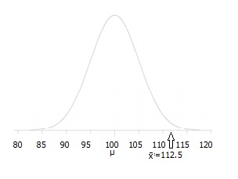
Hypothesis testing Example

Slide 25
Hypothesis testing Example
Step 4: State the alpha level. If you aren’t given an alpha level, use 5% (0.05).
Step 5: Find the rejection region area (given by your alpha level above) from the z-table. An area of .05 is equal to a z-score of 1.645.
Step 6: Find the test statistic using this formula: For this set of data: z= (112.5-100) / (15/√30)=4.56.
Step 6: If Step 6 is greater than Step 5, reject the null hypothesis. If it’s less than Step 5, you cannot reject the null hypothesis. In this case, it is greater (4.56 > 1.645), so you can reject the null.

Slide 26
Hypothesis testing Example
Blood glucose levels for obese patients have a mean of 100 with a standard deviation of 15. A researcher thinks that a diet high in raw cornstarch will have a positive or negative effect on blood glucose levels. A sample of 30 patients who have tried the raw cornstarch diet have a mean glucose level of 140. Test the hypothesis that the raw cornstarch had an effect.
Step 1: State the null hypothesis: H₀:μ=100 Step 2: State the alternate hypothesis: H₁:≠100 Step 3: State your alpha level. We’ll use 0.05 for this example. As this is a two-tailed test, split the alpha into two. 0.05/2=0.025 Step 4: Find the z-score associated with your alpha level. You’re looking for the area in one tail only. A z-score for 0.75(1-0.025=0.975) is 1.96. As this is a two-tailed test, you would also be considering the left tail (z=1.96) Step 5: Find the test statistic using this formula:
z=(140-100)/(15/√30)=14.60. Step 6: If Step 5 is less than -1.96 or greater than 1.96 (Step 4), reject the null hypothesis. In this case, it is greater, so you can reject the null.

Slide 27
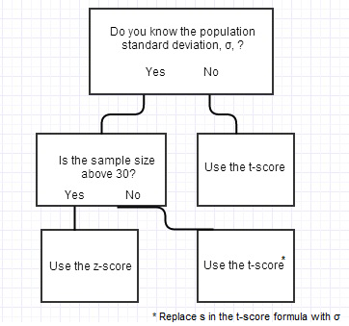
Types of test
Z test- Z = (X – μ) / [ S/√(n) ].
s =SD of the Population
T test - T = (X – μ) / [ σ/√(n) ].
σ =SD of the sample
Look in the T table
F Test- Comparing variance
F = s²₁ / s²₂
Look in the T table

Slide 28
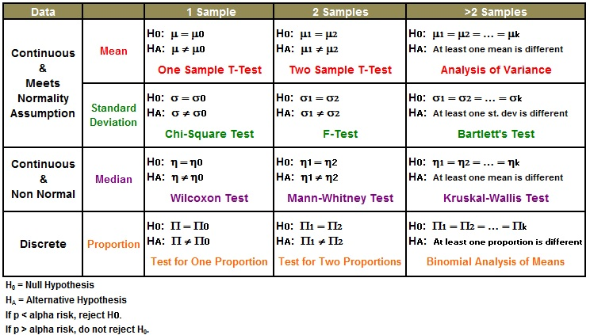
Types of Test

